Slide 1


VIDEO GAMES DATABASE MANAGEMENT SYSTEM
GLOBAL ACADEMY OF TECHNOLOGY
DEPARTMENT OF COMPUTER SCIENCE & ENGINEERING
(Accredited by NBA 2019-2022)
Rajarajeshwari Nagar, Bengaluru – 560 098
Academic Year: 2021 - 22
BY
PRAJNA N 1GA19CS109
NAYAN V BHANDARI 1GA19CS095
GUIDE: PROF.RESHMA.S
18CSL58 DATABASE MANAGEMENT SYSTEM LABORATORY
GAT , CSE

Slide 2
ABSTRACT
A video games database management system is the company’s way of managing its resources. It ensures that the logistics are in check and the company has reach to everyone linked to it through its products to ensure there are no discrepancies in the progress of the company.
18CSL58 DATABASE MANAGEMENT SYSTEM LABORATORY
GAT , CSE

Slide 3
Problem Statement
The website can be considered as a platform for the company to hoard details of all the games sold at any of its markets. It has details about the game and its origin for patenting and trademark reasons. Only the employees at our stores have access to this database through a unique identification key .Customers receive their invoice after providing the essential details.
GAT , CSE
18CSL58 DATABASE MANAGEMENT SYSTEM LABORATORY

Slide 4
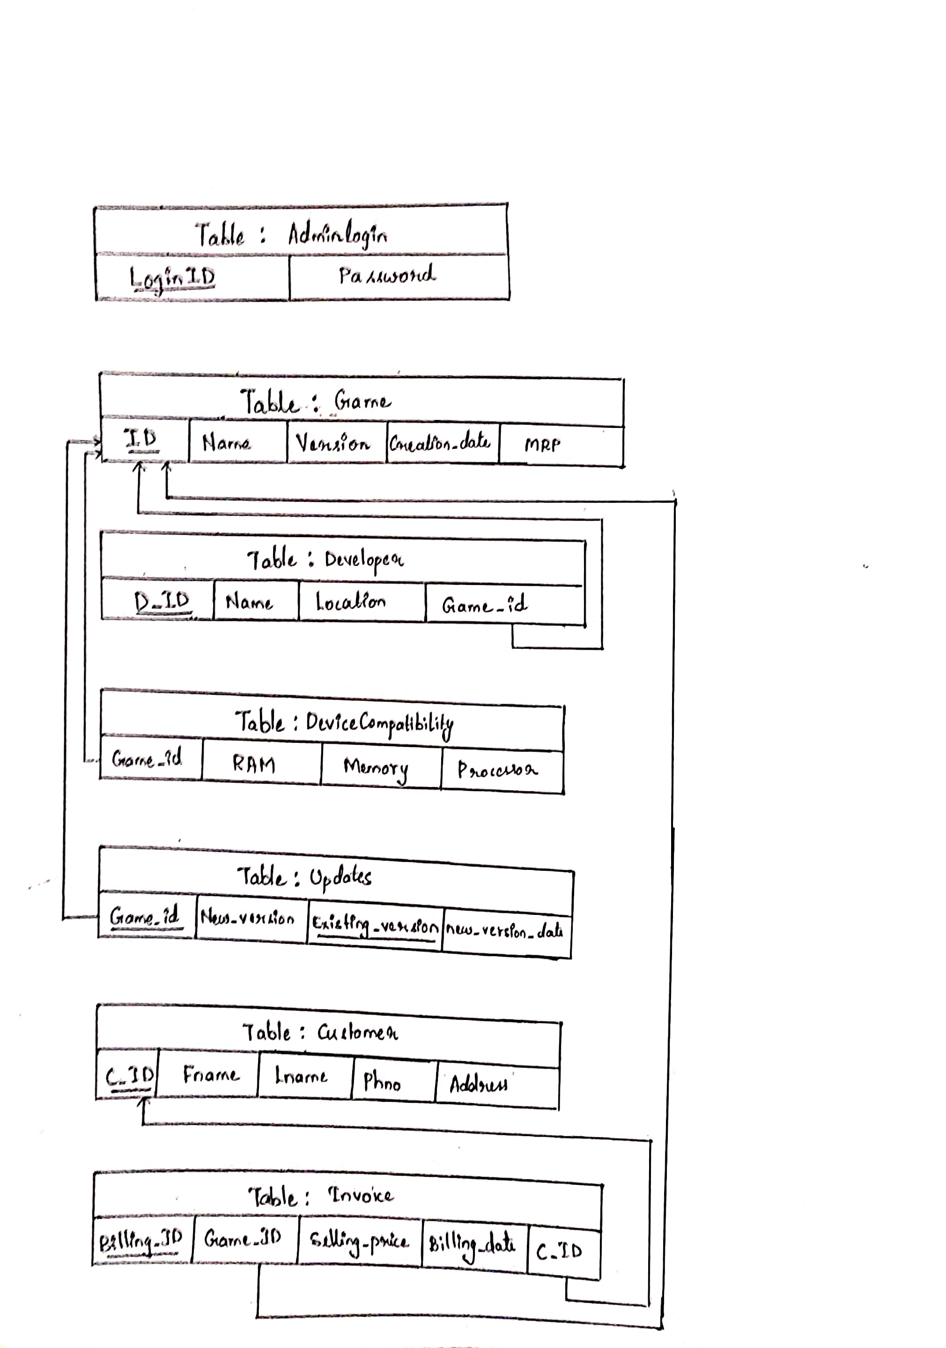
SCHEMA DIAGRAM
GAT , CSE
18CSL58 DATABASE MANAGEMENT SYSTEM LABORATORY

Slide 5
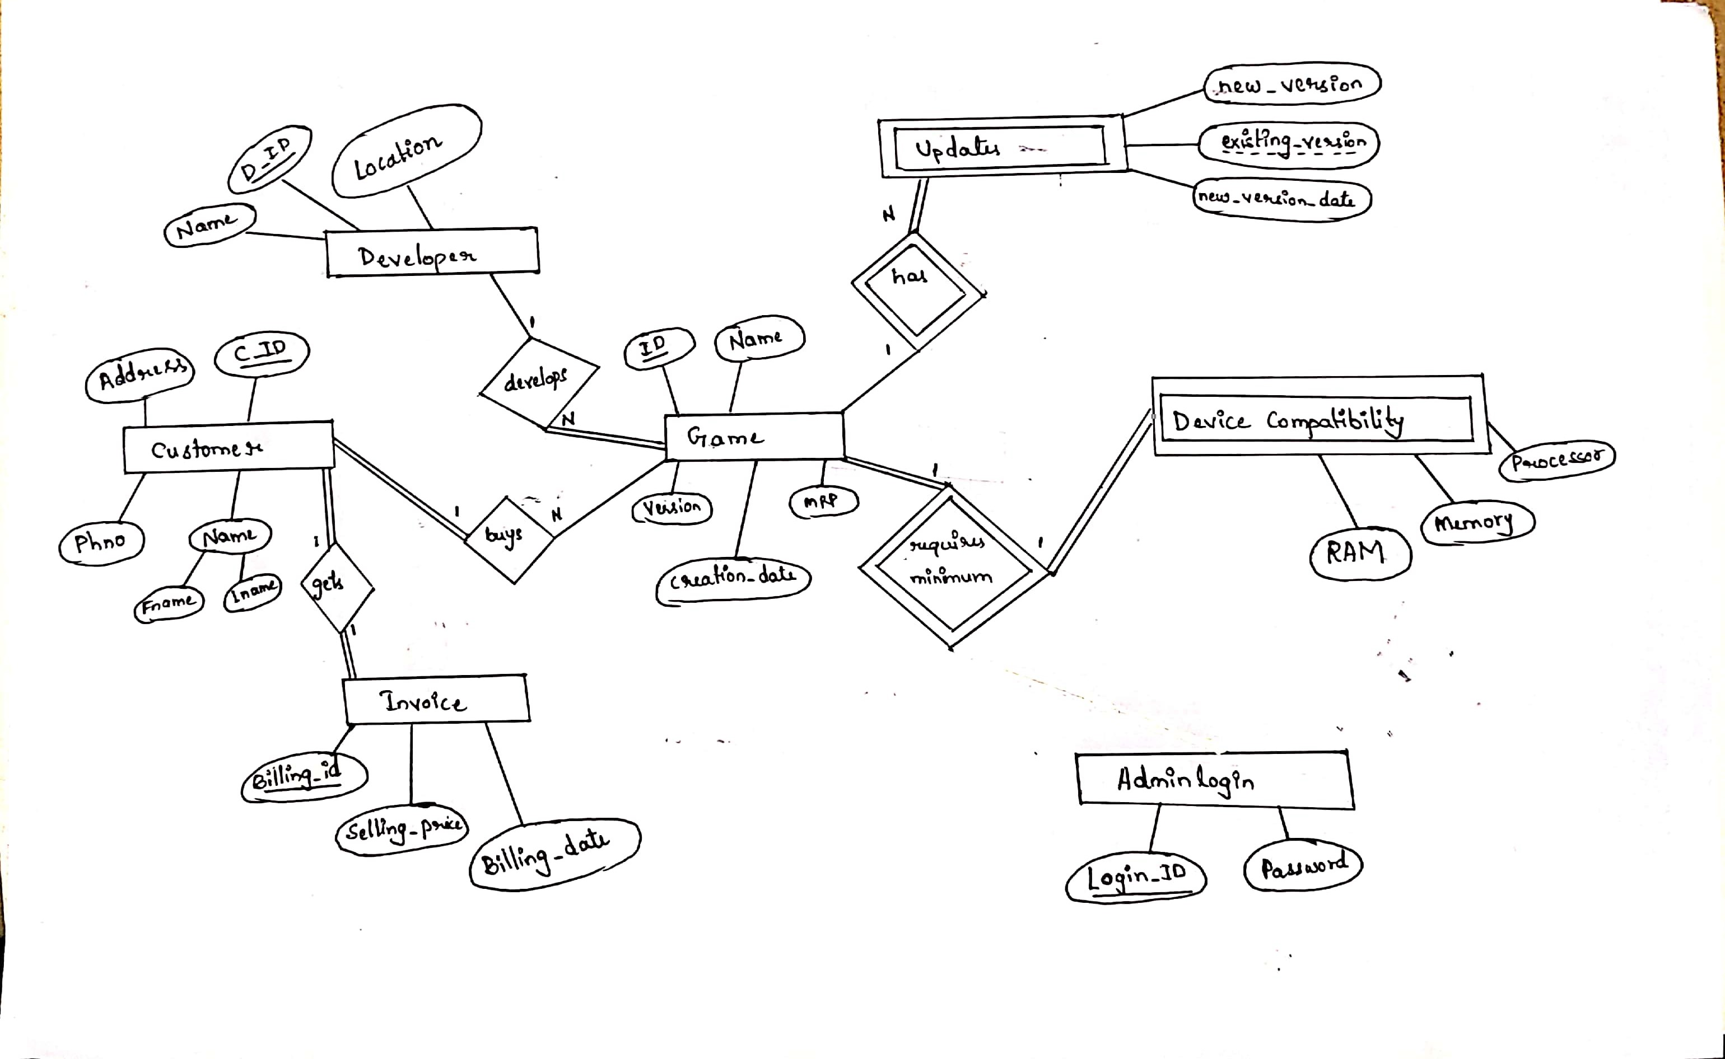
ER Diagram
GAT , CSE
18CSL58 DATABASE MANAGEMENT SYSTEM LABORATORY

Slide 6
REQUIRED LANGUAGES
Front End- HTML, CSS
Back End- MariaDB, PHP, Apache
GAT , CSE
18CSL58 DATABASE MANAGEMENT SYSTEM LABORATORY

Slide 7
SQL QUERIES
CREATE TABLE game
(
ID varchar(5) PRIMARY KEY,
Name varchar(20) NOT NULL,
Version varchar(5),
Creation_date date,
MRP dec(7,2),
Stock Integer(5)
);
CREATE TABLE DeviceCompatibility
(
Game_id varchar(5),
RAM integer(3) CHECK (RAM>=8),
Memory varchar(10),
Processor varchar(10),
FOREIGN KEY (Game_id) REFERENCES game(ID)ON DELETE CASCADE
);
18CSL58 DATABASE MANAGEMENT SYSTEM LABORATORY
GAT , CSE

Slide 8
CREATE TABLE Updates
(
game_id varchar(5),
new_version varchar(5),
existing_version varchar(5),
new_version_date date,
FOREIGN KEY (game_id) REFERENCES game(ID)ON DELETE CASCADE,
PRIMARY KEY(game_id,existing_version)
);
18CSL58 DATABASE MANAGEMENT SYSTEM LABORATORY
GAT , CSE

Slide 9
CREATE TABLE Customer
(
c_id varchar(5) PRIMARY KEY,
Fname varchar(20) NOT NULL,
Lname varchar(20),
Phno bigint(10) NOT NULL,
Address varchar(50) NOT NULL
);
CREATE TABLE Invoice
(
billing_id varchar(5) PRIMARY KEY,
game_id varchar(5) NOT NULL,
Selling_price DEC(7,2),
Billing_date DATETIME DEFAULT CURRENT_TIMESTAMP ON UPDATE
CURRENT_TIMESTAMP,
c_id varchar(5),
FOREIGN KEY (c_id) REFERENCES customer(c_id)ON DELETE CASCADE,
FOREIGN KEY (game_id) REFERENCES game(ID)ON DELETE CASCADE
);
GAT , CSE
18CSL58 DATABASE MANAGEMENT SYSTEM LABORATORY

Slide 10
CREATE TABLE Developer
(
D_ID varchar(5) PRIMARY KEY,
Name varchar(20) NOT NULL,
Location varchar(20) NOT NULL,
game_id varchar(5) NOT NULL,
FOREIGN KEY (game_id) REFERENCES game(ID)ON DELETE CASCADE
);
18CSL58 DATABASE MANAGEMENT SYSTEM LABORATORY
GAT , CSE

Slide 11
Insertion
Game
Insert into Game values("VG01",”League of legends”,1,”2009-10-27”,1500.0,2300);
Insert into Game values("VG02",’Valorant”,1,”2020-06-02”,0.0,6000);
Insert into Game values("VG03",”Watch Dogs”,1,”2014-05-27”,1000.0,800);
Insert into Game values("VG04",”CALL OF DUTY”,1,”2003-10-29”,2850.0,2100);
Insert into Game values("VG05",”ASSASSINS CREED”,1,”2007-09-13”,1200.0,900);
18CSL58 DATABASE MANAGEMENT SYSTEM LABORATORY
GAT , CSE

Slide 12
DeviceCompatibility
Insert into DeviceCompatibility values("VG01", 8, "1 TB HDD", "AMD Ryzen 5");
Insert into DeviceCompatibility values("VG02", 8, "1 TB HDD", "Intel core i5-12600K");
Insert into DeviceCompatibility values("VG03", 8, "1 TB HDD","AMD Ryzen 7");
Insert into DeviceCompatibility values("VG04", 8, "256 GB SSD and 1 TB HDD", "Intel core i7-9700K");
Insert into DeviceCompatibility values("VG05", 8,"1 TB HDD", "AMD Ryzen 5");
18CSL58 DATABASE MANAGEMENT SYSTEM LABORATORY
GAT , CSE

Slide 13
Developer
Insert into Developer values('D1','Riot Games’, 'Los Angeles','VG01');
Insert into Developer values('D2','Riot Games’, 'Los Angeles','VG02');
Insert into Developer values('D3','Ubisoft Montreal','Montreuil','VG03');
Insert into Developer values('D4','Activision','California','VG204');
Insert into Developer values('D5','Ubisoft Montreal','Montreuil','VG205');
18CSL58 DATABASE MANAGEMENT SYSTEM LABORATORY
GAT , CSE

Slide 14
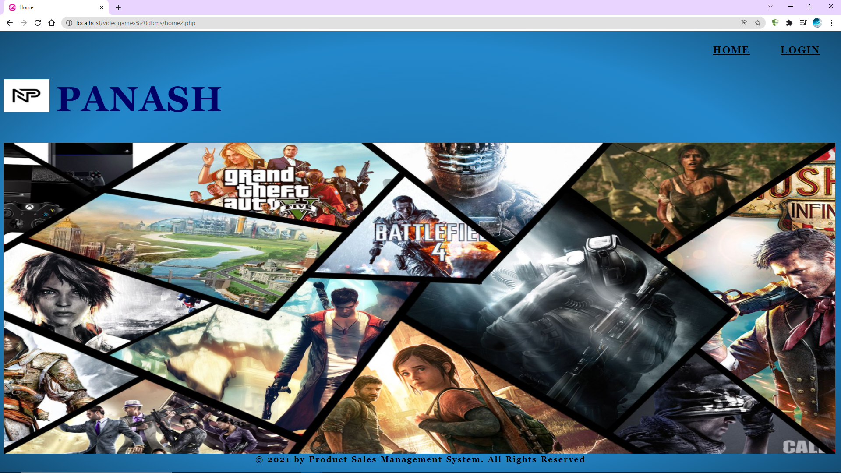
18CSL58 DATABASE MANAGEMENT SYSTEM LABORATORY
GAT , CSE

Slide 15
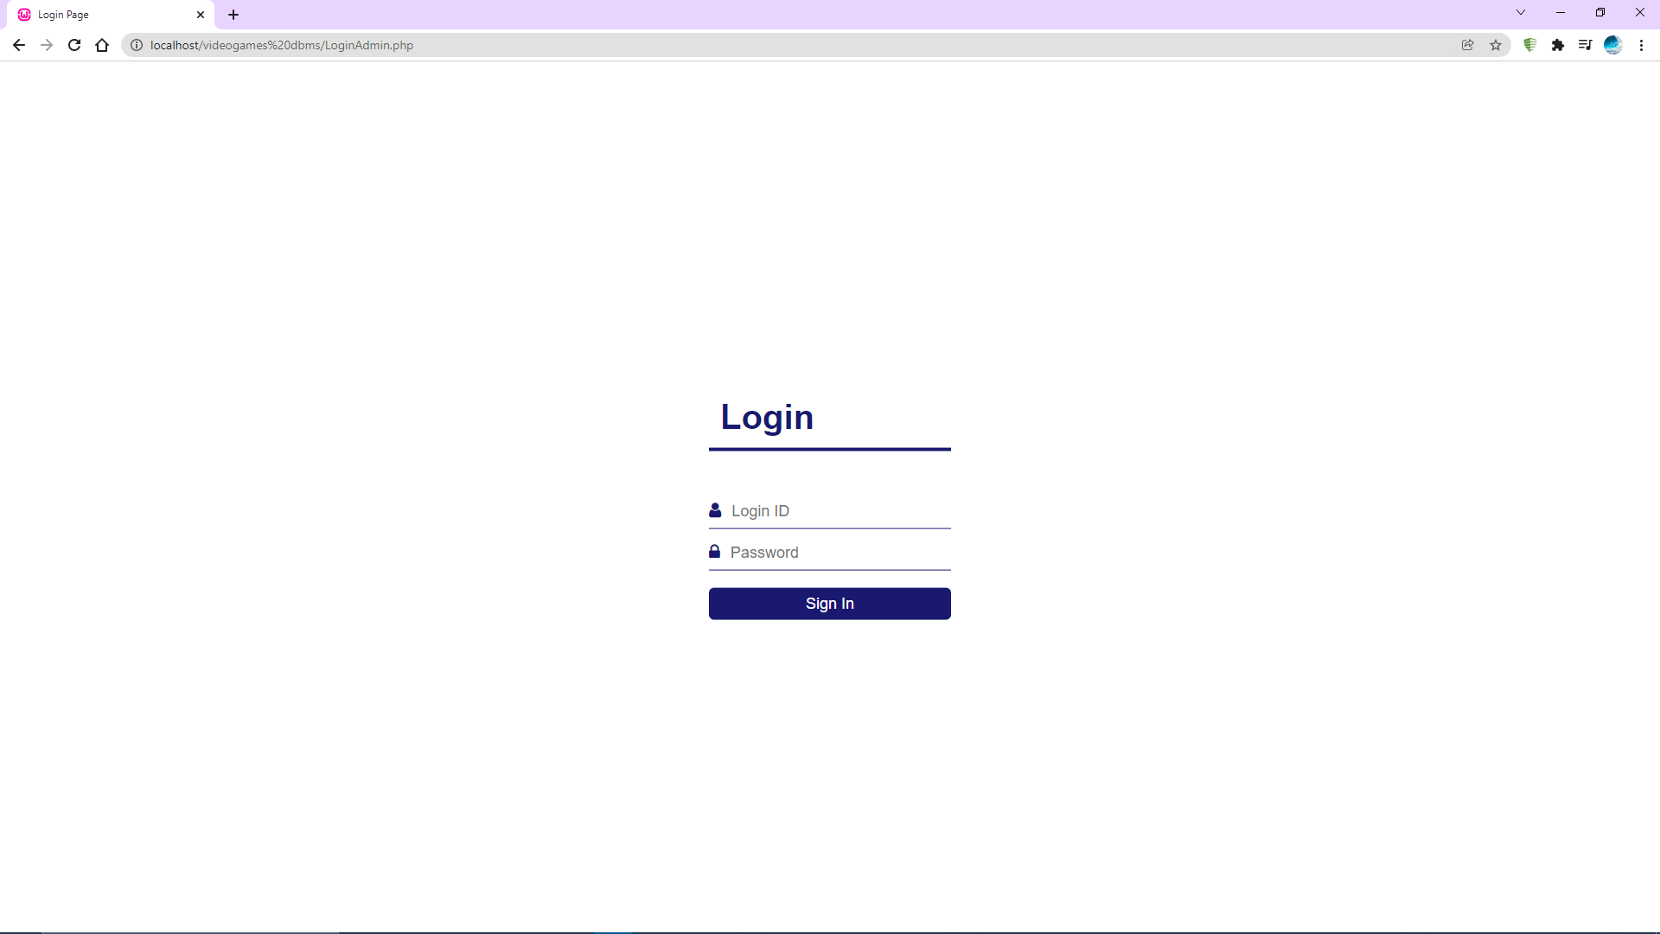
18CSL58 DATABASE MANAGEMENT SYSTEM LABORATORY
GAT , CSE

Slide 16
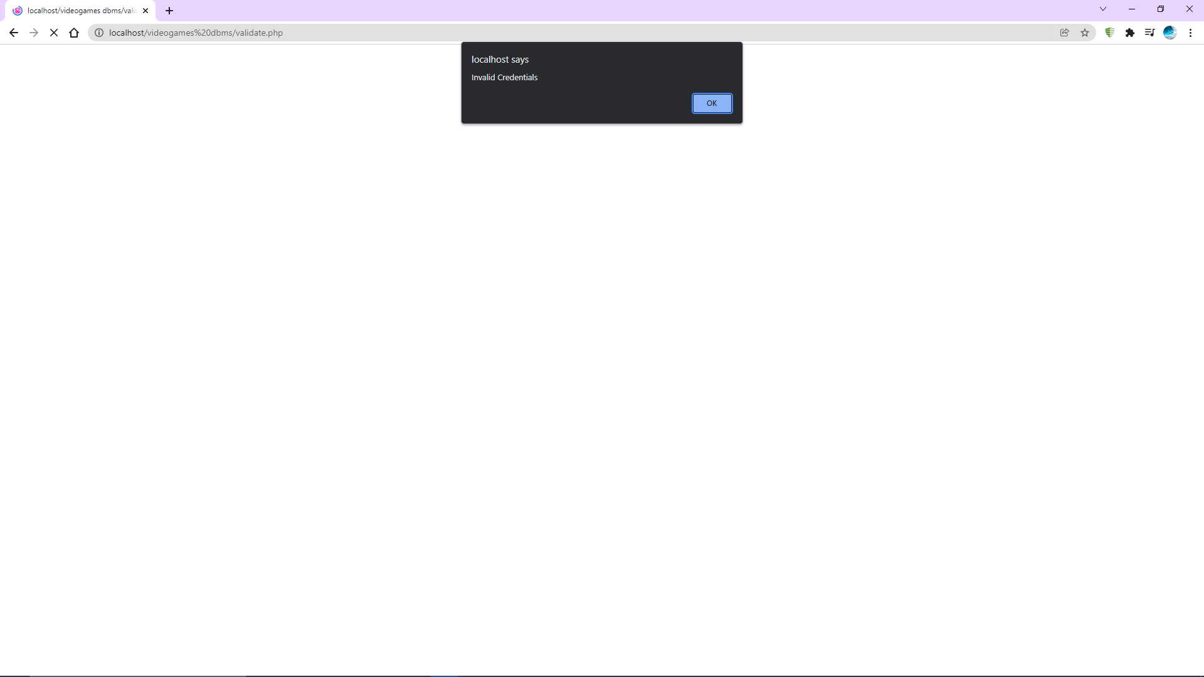
18CSL58 DATABASE MANAGEMENT SYSTEM LABORATORY
GAT , CSE

Slide 17
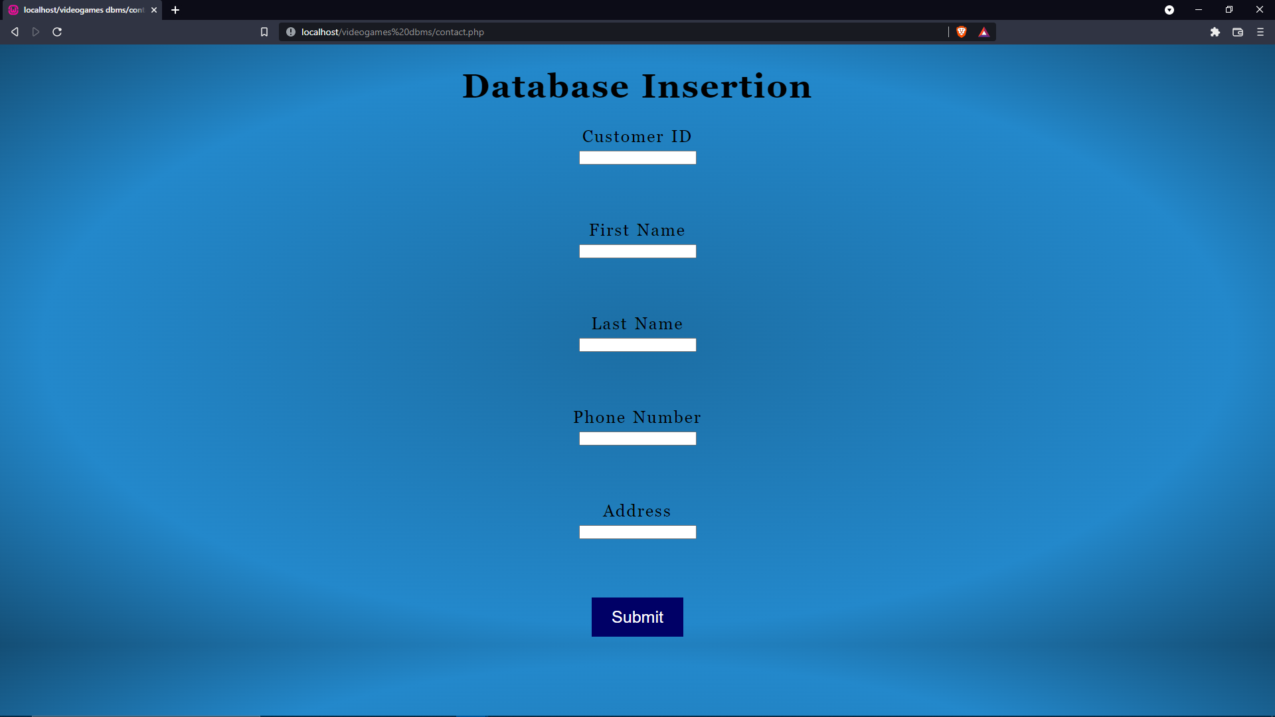
18CSL58 DATABASE MANAGEMENT SYSTEM LABORATORY
GAT , CSE

Slide 18
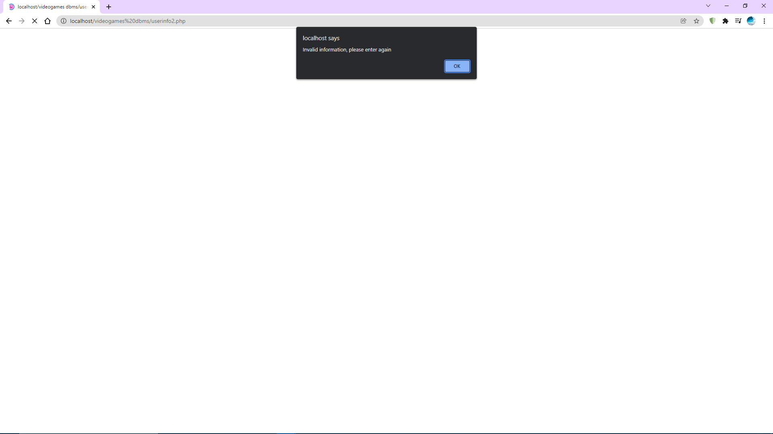
18CSL58 DATABASE MANAGEMENT SYSTEM LABORATORY
GAT , CSE

Slide 19
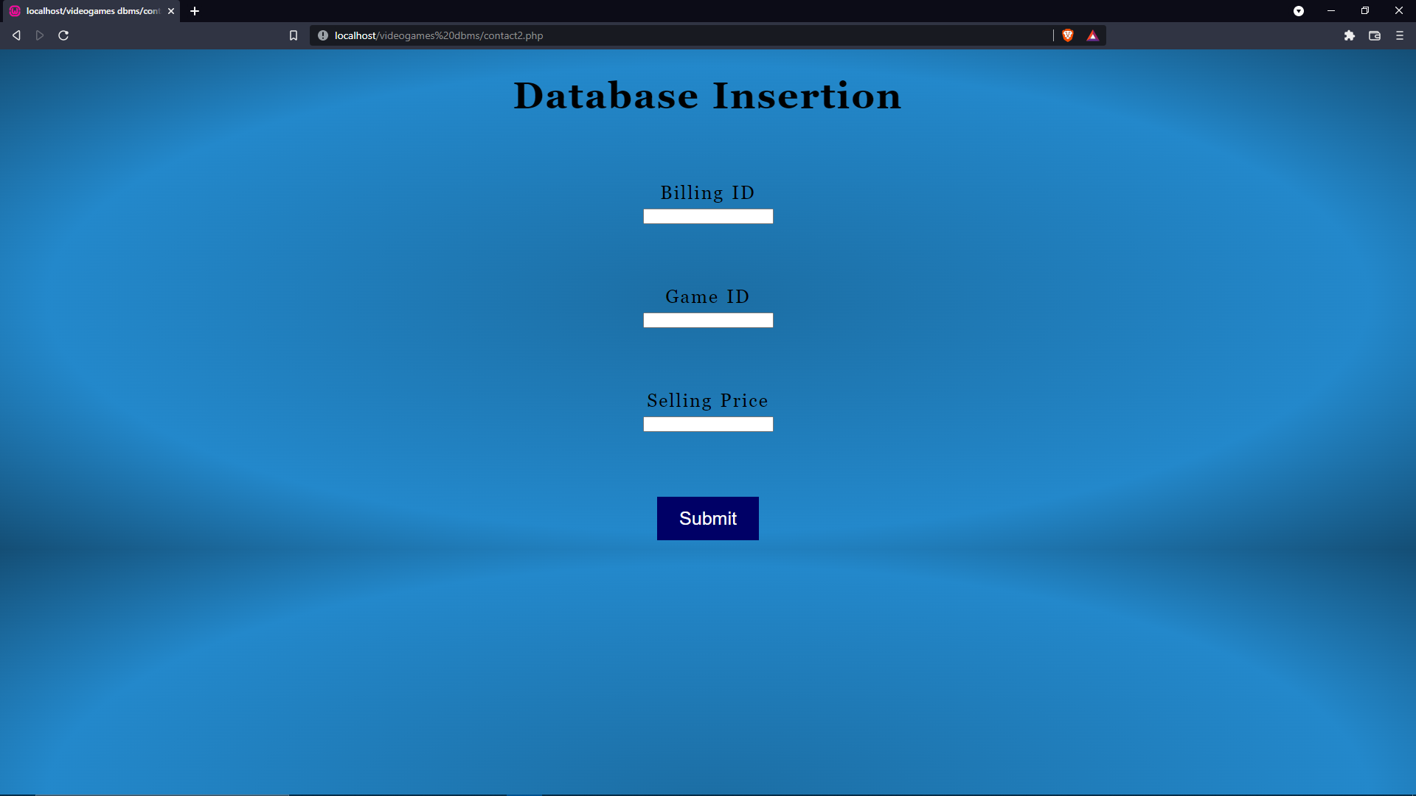
18CSL58 DATABASE MANAGEMENT SYSTEM LABORATORY
GAT , CSE

Slide 20
18CSL58 DATABASE MANAGEMENT SYSTEM LABORATORY
GAT , CSE

Slide 21
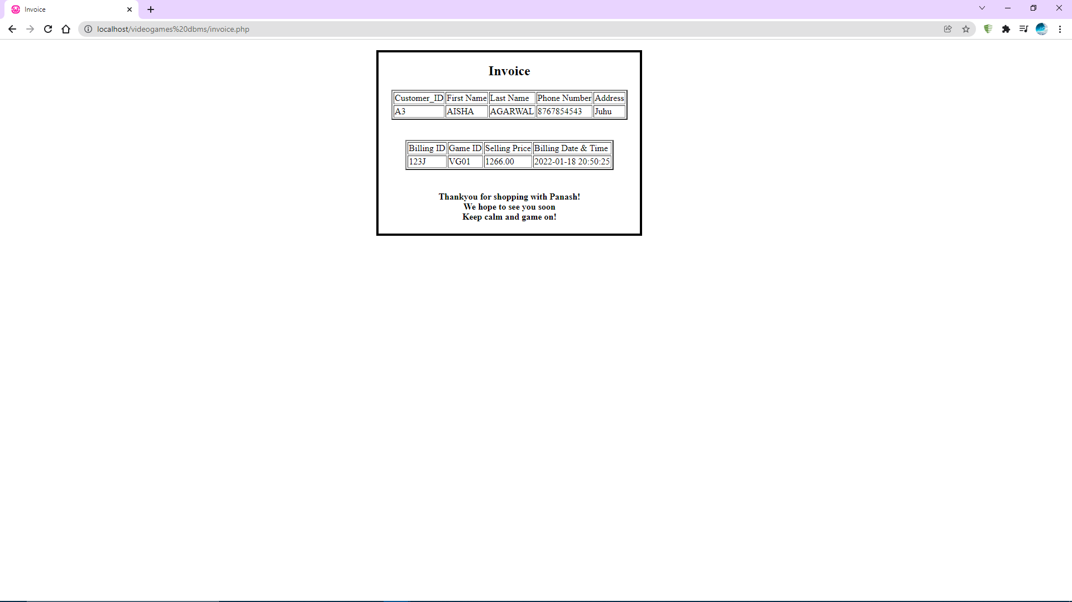
18CSL58 DATABASE MANAGEMENT SYSTEM LABORATORY
GAT , CSE

Slide 22
THANK YOU
18CSL58 DATABASE MANAGEMENT SYSTEM LABORATORY
GAT , CSE

